Slide 1

M.Praveena
V.Abirami
02 JUNE 2025

Slide 2


Let’s Think About This…
We go to school for years…
But, Are we really ready for real life?

Slide 3

Introduction – School Vs Real Life
What is Missing
We pass exams, but feel unprepared for real life
School teaches facts, not always real-world skills
Life lessons like confidence, emotions, and money are often missing
This presentation explores what school doesn’t teach us—but life does

Slide 4
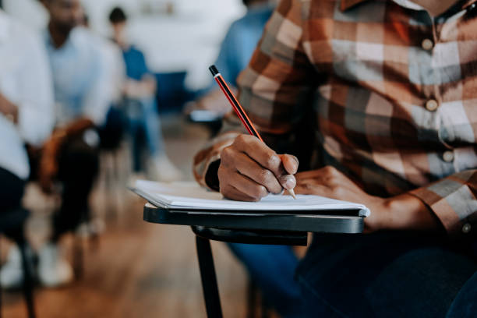
Objective – Why We Chose This Topic?
To highlight that real education means learning life skills-not just passing exams.

Slide 6




Presentation Overview
Finding Your Passion
Real-World Skills
Communication
& Confidence
Emotions & Mental Strength

Slide 7

Communication &
Confidence
How to speak confidently: Learn how to speak clearly and without hesitation. You don’t need to be perfect, just be comfortable with yourself.
Building self-confidence: It’s important to believe in yourself. Confidence comes from practice, not just talent.
Listening well: Being a good listener is just as important as speaking. It helps you understand others and shows that you care.

Slide 8
Finding Your Passion
Real-World Skills
Communication
& Confidence
Emotions & Mental Strength

Slide 9

Finding Your Passion
Discovering what excites you: School teaches many subjects, but it doesn’t always show you what you truly enjoy. Finding your passion is about figuring out what makes you happy.
Exploring different career options: It's important to explore many fields and hobbies to see what fits your interests best.
Why passion matters: When you love what you do, it makes working hard easier and more fun. Passion motivates you to achieve your goals.

Slide 10
Finding Your Passion
Real-World Skills
Communication
& Confidence
Emotions & Mental Strength

Slide 11


Emotions & Mental Strength
Understanding emotions: We all feel happy, sad, or stressed at times. Understanding your emotions helps you manage them better.
Dealing with stress: Life can be stressful, but learning how to stay calm and manage your stress is important for mental health.
Building emotional strength: Mental strength helps you keep going, even when things are tough. It’s about handling failure, disappointment, and overcoming challenges.

Slide 12
Finding Your Passion
Real-World Skills
Communication
& Confidence
Emotions & Mental Strength

Slide 13
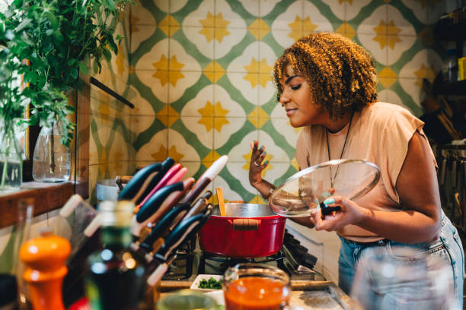
Real-World Skills
Managing money: Schools don’t teach us how to budget or save. Understanding money is key to living independently.
Time management: Learning how to manage your time helps you to be organized, finish tasks on time, and avoid last-minute stress.
Job preparation: Knowing how to write a good resume, prepare for interviews, and behave in a professional setting are crucial for success.

Slide 14

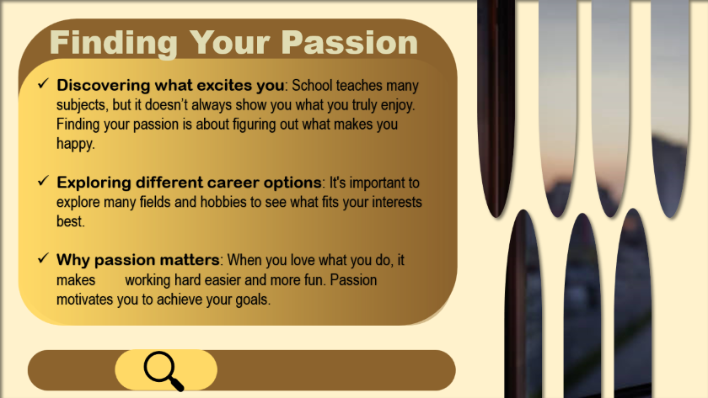
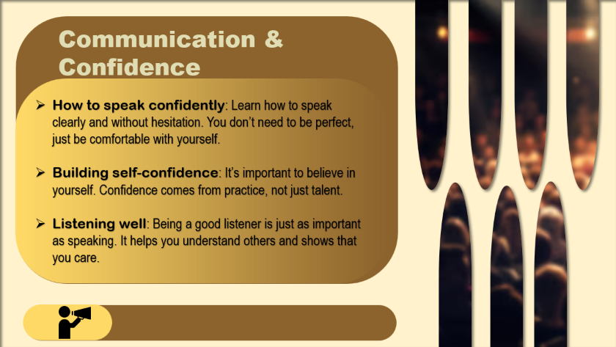
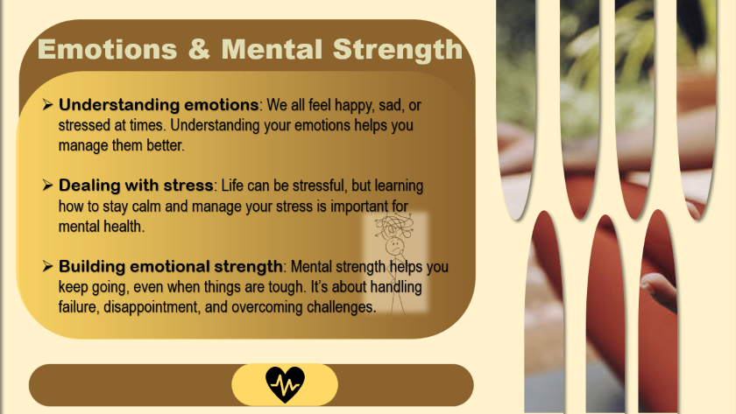
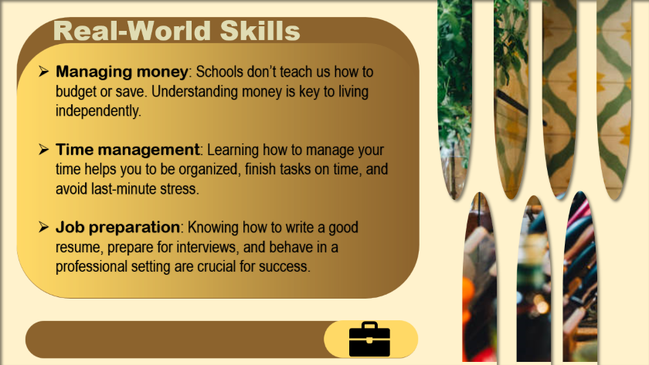

Slide 15

Conclusion
School gives us knowledge, but life needs real-world skills.
We must learn things like confidence, emotions, and how to handle stress.
Keep growing, keep learning — life is the biggest teacher.

Slide 16

A Question For You….
What do you think we should do to learn
skills school doesn’t teach?

Slide 17

Our Ideas….
Start a weekly life skills club where students practice talking, budgeting, or teamwork.
Use class projects or drama to build confidence and communication skills.
Invite local professionals like artists, shop owners, or engineers to share their stories.
Encourage students to try new hobbies in after-school programs.

Slide 18



Any Questions

Slide 19

----------------
Thank you
V.Abirami
M.Praveena
02 JUNE 2025

